Slide 1
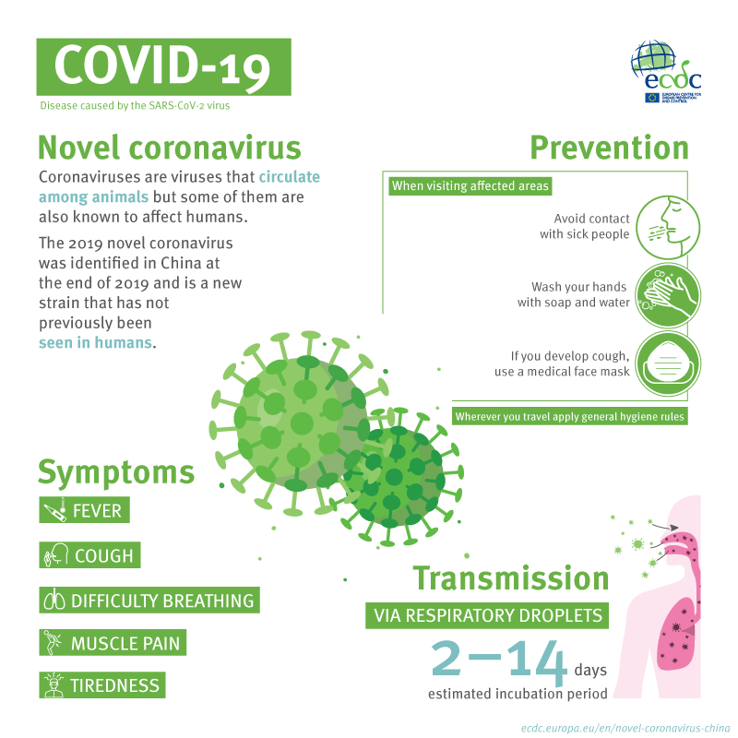

Slide 2


COMPETENCE
Reading different English texts as a foreign language.
SKILL:
Infer
CAPACITY
Infer and interpret information from written texts

Slide 3
OBJECTIVE
Reviewing grammar structures and vocabulary

Slide 4

TIME TO OPEN YOUR STUDENT’S BOOK!
Pag. 34

Slide 5

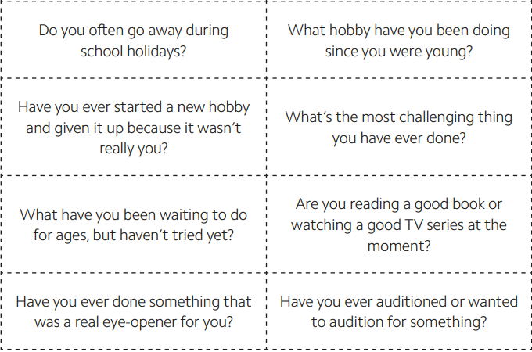
T chooses some ss to answer. Ss use present tenses.

Slide 6
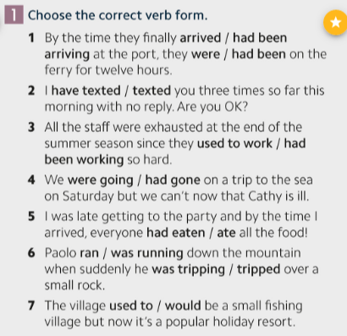
VOLUNTEERS TO SAY THE ANSWERS ☺

Slide 7
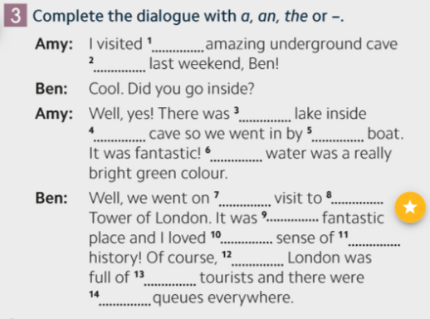
VOLUNTEERS TO SAY THE ANSWERS ☺
an
-
a
the
-
the
a
the
a
the
-
-
-
-

Slide 8
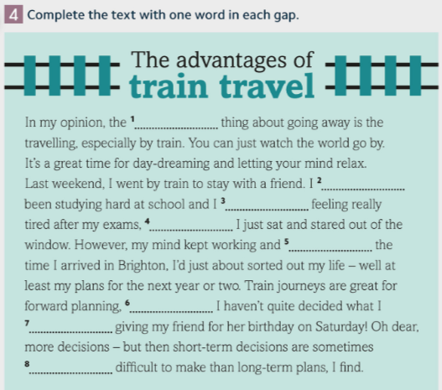
VOLUNTEERS TO SAY THE ANSWERS ☺
best
had
was
so
by
although
and
more

Slide 9
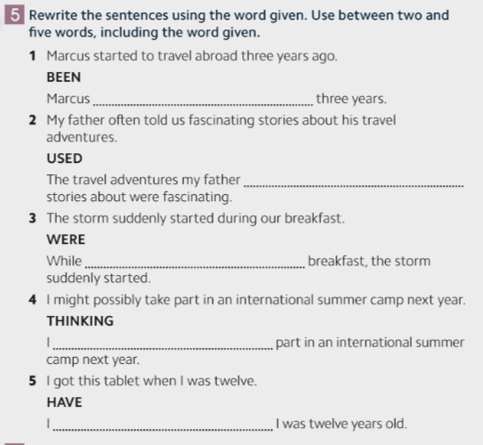
VOLUNTEERS TO SAY THE ANSWERS ☺
had been travelling abroad for
used to tell
we were having
was thinking of taking
have had this table since

Slide 10
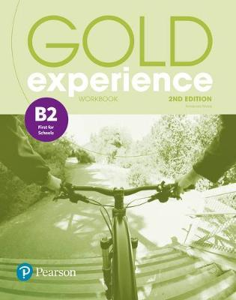
TIME TO OPEN YOUR WORKBOOKS!
Pag. 23

Slide 11
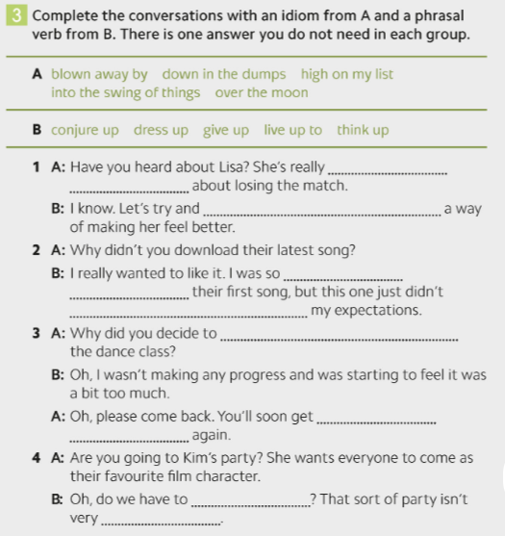
VOLUNTEERS TO SAY THE ANSWERS ☺
down in the dumps
think up
blown away by
live up to
give up
into the swing of things
dress up
high on my list

Slide 12

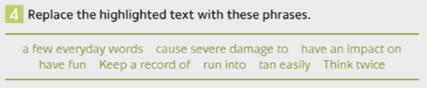
VOLUNTEERS TO SAY THE ANSWERS ☺
1. have fun
2. keep a record of
3. run into
4. cause severe damage to
5. tan easily
6. a few everyday words
7. have an impact on

Slide 13
METACOGNITION
*What did you learn today?
Which task was the most difficult to do? Why?

Slide 14
RESOURCES
ECDC (2020). Coronavirus. Taken from: https://www.deutschland.de/es/node/14782
Pearson Online Resources. (2018). Gold Experience Second Edition. Taken from: https://english-dashboard.pearson.com/toc/goldxpb2/lessons/gxp-b2%7C3.8.8/card
S. Juliars (2020) . Fountain pen cartoon icon vector image. Taken from: https://www.vectorstock.com/royalty-free-vector/fountain-pen-cartoon-icon-vector-7217062
Giphy (2020). Readimg. Taken from: https://giphy.com/gifs/26vUO243JaWWq4los

