Slide 1
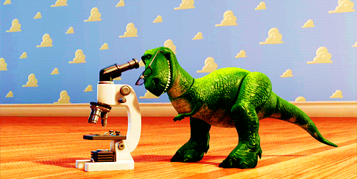

Slide 2


Slide 3
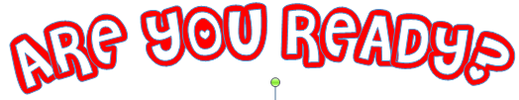


Slide 4

https://www.youtube.com/watch?v=CzO3aIe0Rps

Slide 5

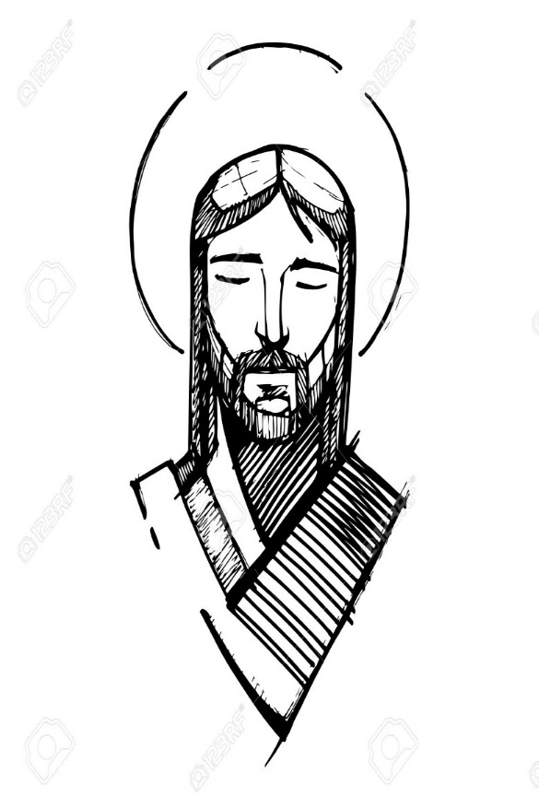
LOVE

Slide 6
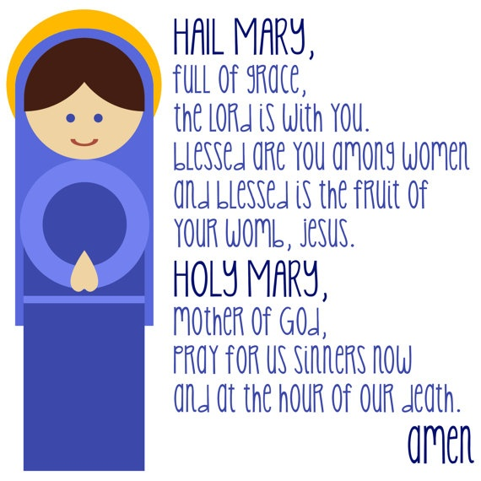

Slide 7



Slide 8
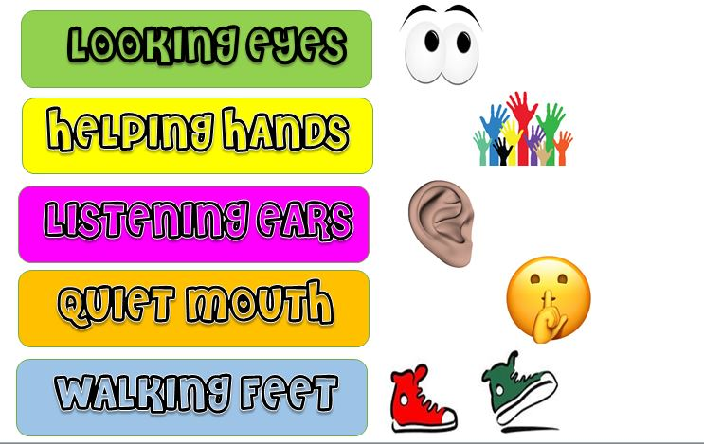

Slide 9



Slide 10


Slide 11

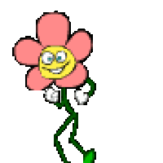

Objective of the class
Communicate parts and functions of the plant

Slide 12



https://www.youtube.com/watch?v=dJjNh2pMSB8

Slide 13



Slide 14
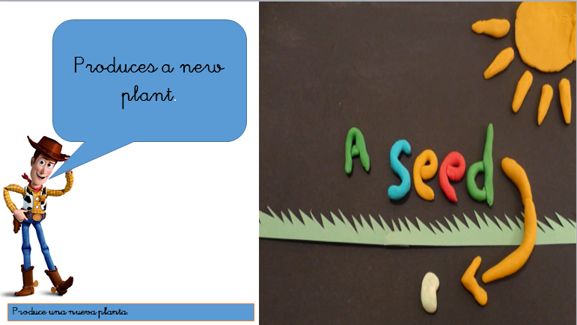

Slide 15
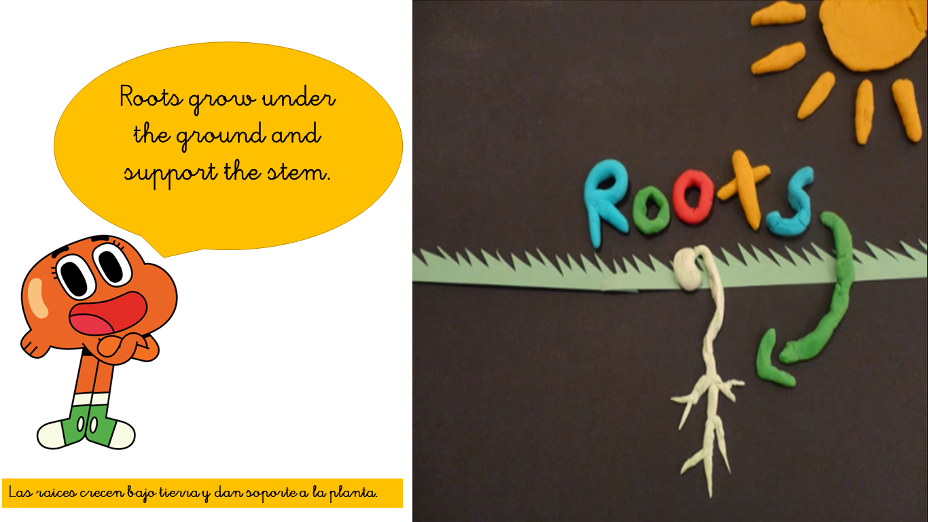

Slide 16
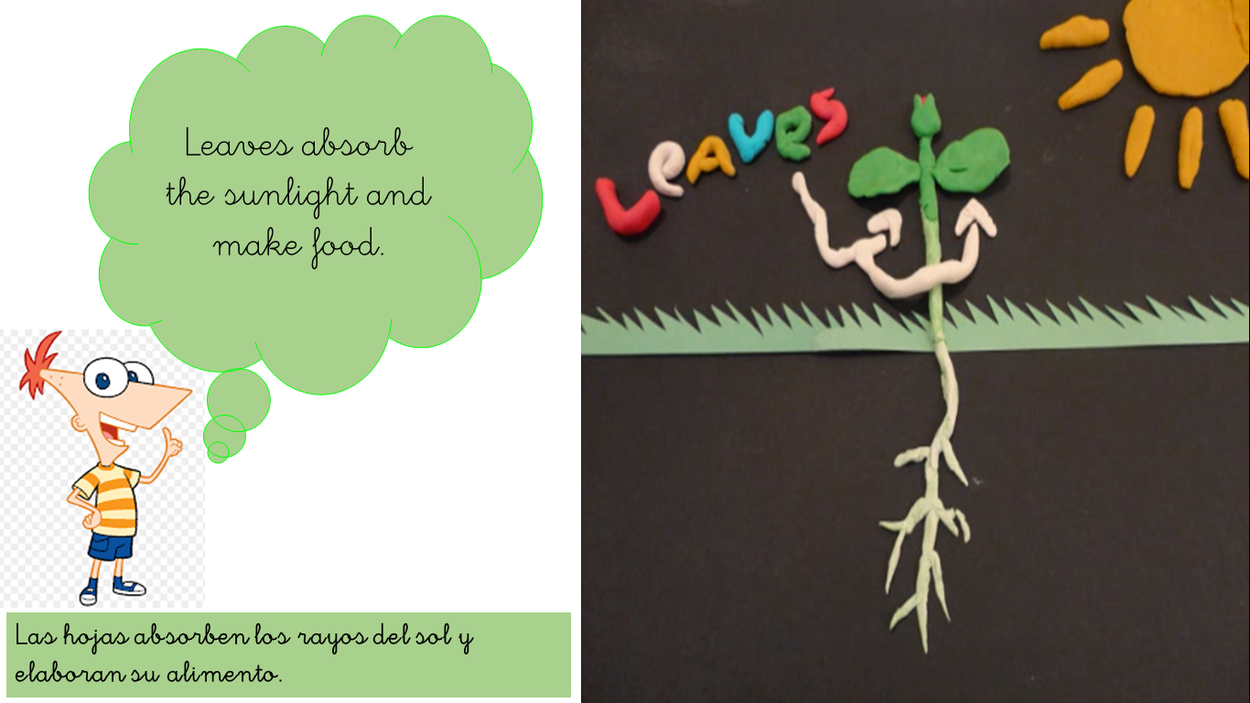

Slide 17
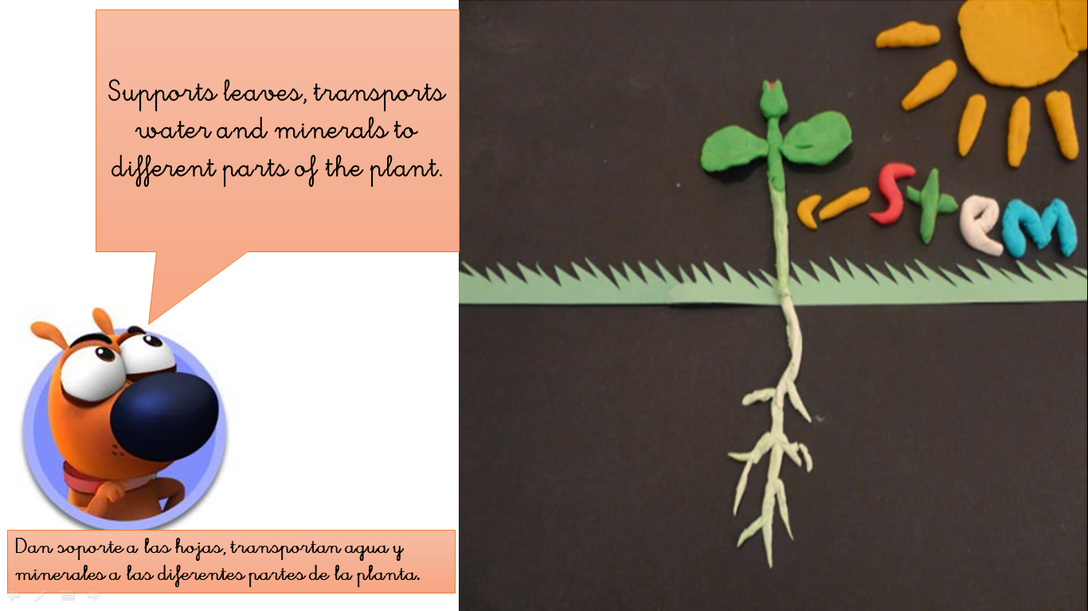

Slide 18
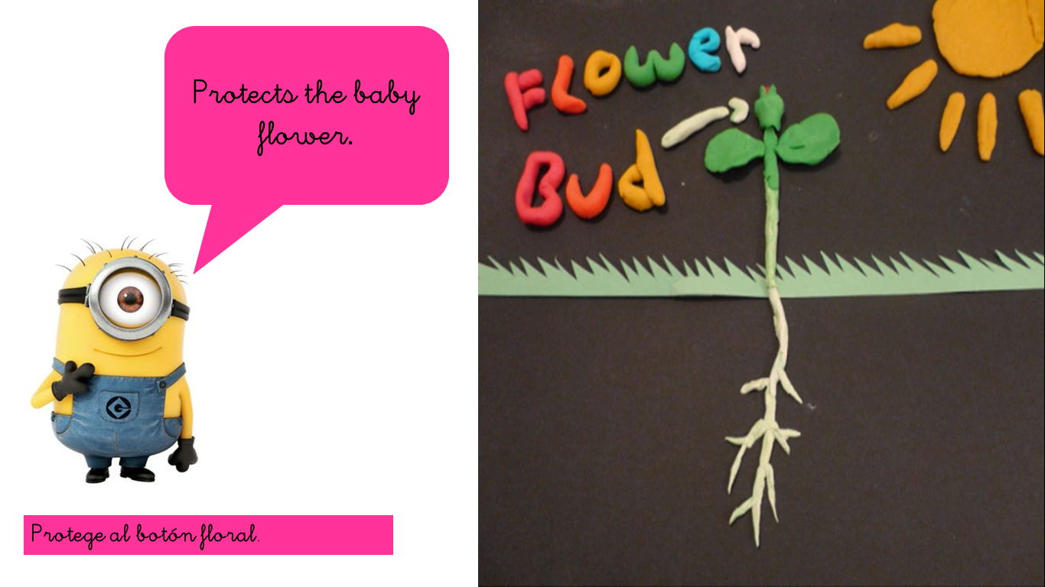

Slide 19
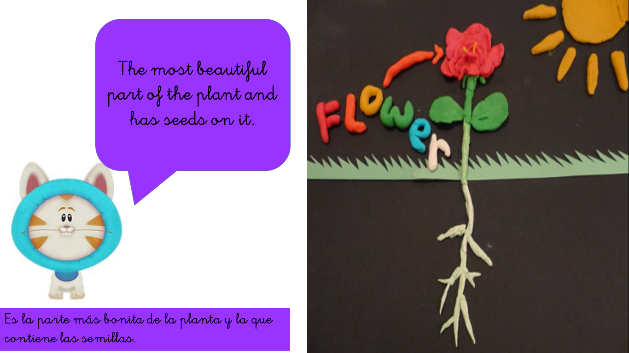

Slide 20



Slide 21

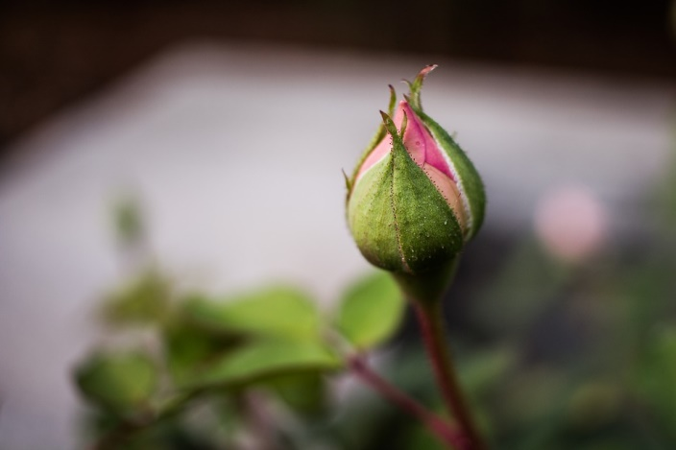
LEAVES
FLOWER BUD
FLOWER
A
B
C

Slide 22
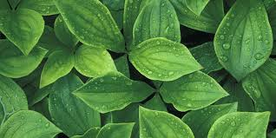
STEM
ROOTS
LEAVES
A
B
C

Slide 23
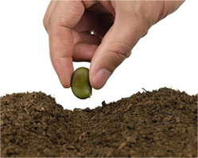
SEED
FLOWER BUD
LEAVES
A
B
C

Slide 24
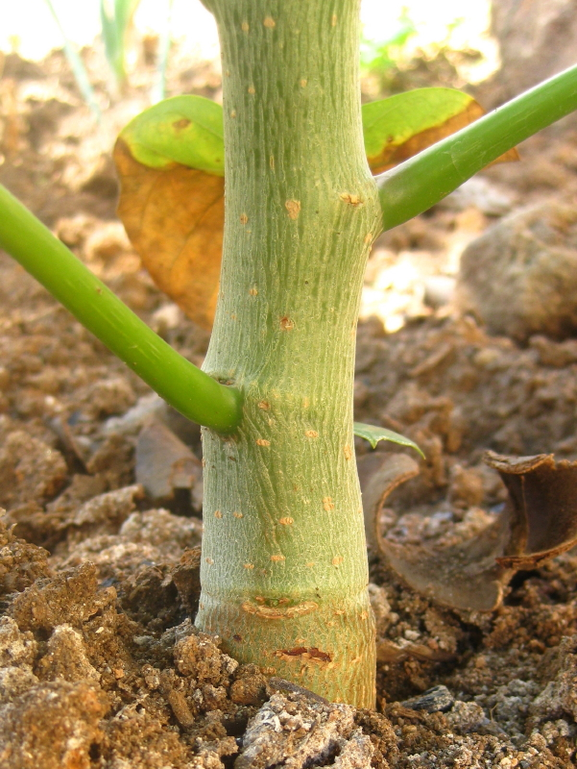
STEM
ROOTS
LEAVES
A
B
C

Slide 25
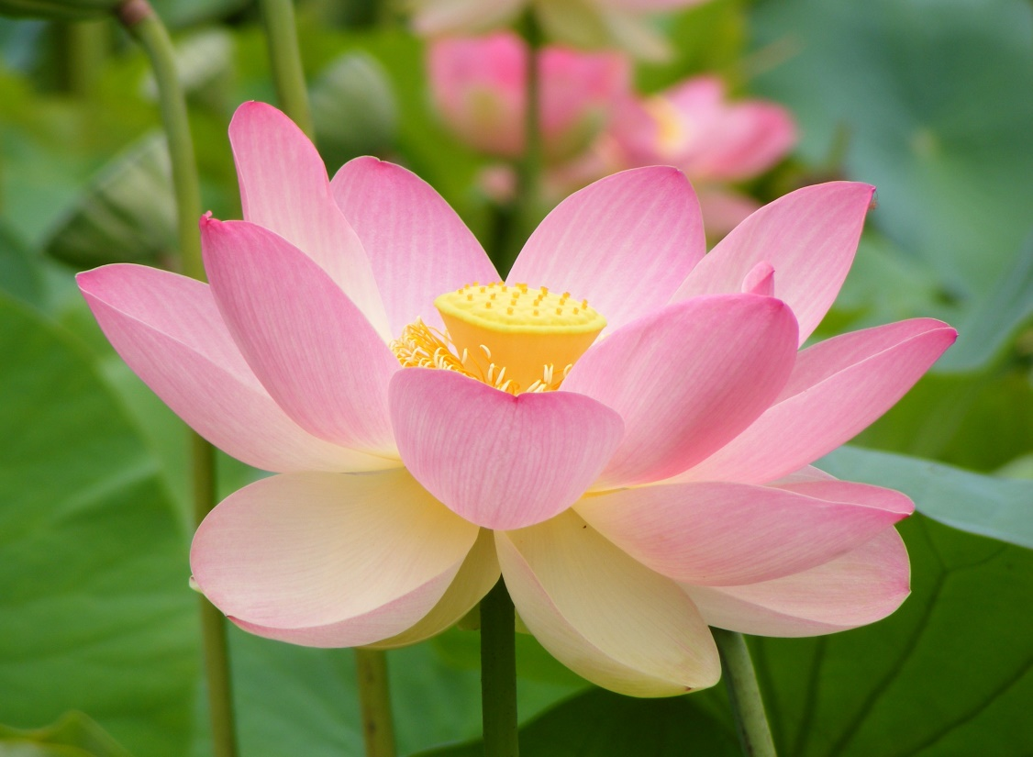
FLOWER BUD
FLOWER
LEAVES
A
B
C

Slide 26
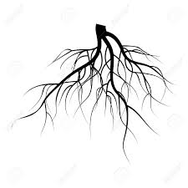
SEED
STEM
ROOTS
A
B
C

Slide 27

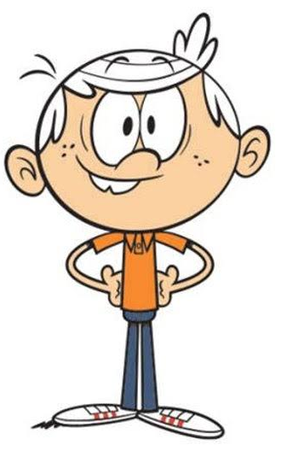

Slide 28
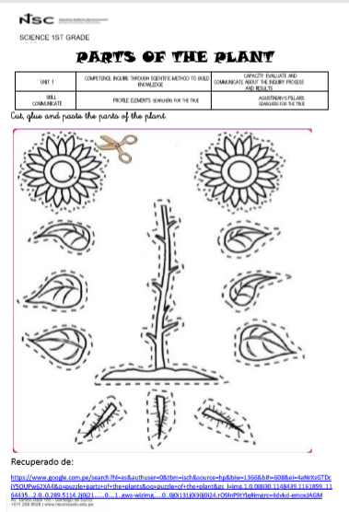



Slide 29
